Slide 1
DESIGN AND ANALYSIS OF ALGORITHM-18CSC204J MINI-PROJECT
Done By –VEDANT TIWARI(ra2011003010354)

Slide 2
TOPIC
A TIC-TAC-TOE GAME

Slide 3
Problem Statement
The Tic –Tac-Toe game is to be played between two people (in this program between HUMAN and COMPUTER). One of the players chooses ‘O’ and the other ‘X’ to mark their respective cells. The game starts with one of the players and the game ends when one of the players has one whole row/ column/ diagonal filled with his/her respective character (‘O’ or ‘X’). If no one wins, then the game is said to be draw.

Slide 4
Selection of Algorithm design strategy
Backtracking
It is a technique based on algorithm to solve problem. It uses recursive calling to find the solution by building a solution step by step increasing values with time. It removes the solutions that doesn't give rise to the solution of the problem based on the constraints given to solve the problem. For this problem we are going to use minimax algorithm.

Slide 5
Mini-max Algorithm
Mini-max algorithm is a backtracking algorithm which is used in decision-making and game theory. It provides an optimal move for the player assuming that opponent is also playing optimally. It uses recursion to search through the game-tree. This Algorithm computes the minimax decision for the current state. In this algorithm two players play the game, one is called MAX and other is called MIN. Both the players fight it as the opponent player gets the minimum benefit while they get the maximum benefit. The minimax algorithm performs a depth-first search algorithm for the exploration of the complete game tree. The minimax algorithm proceeds all the way down to the terminal node of the tree, then backtrack the tree as the recursion.

Slide 6
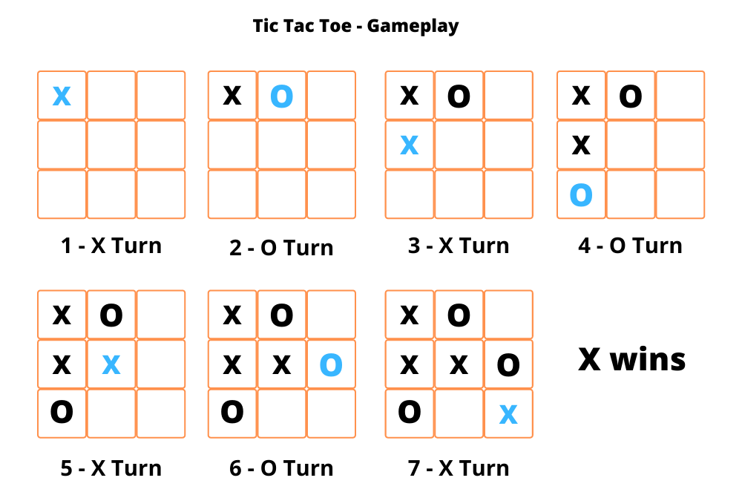
Presentation

Slide 7
THANK YOU

